Slide 1
Google Earth Scavenger Hunt
By Gavin McRoy

Slide 2
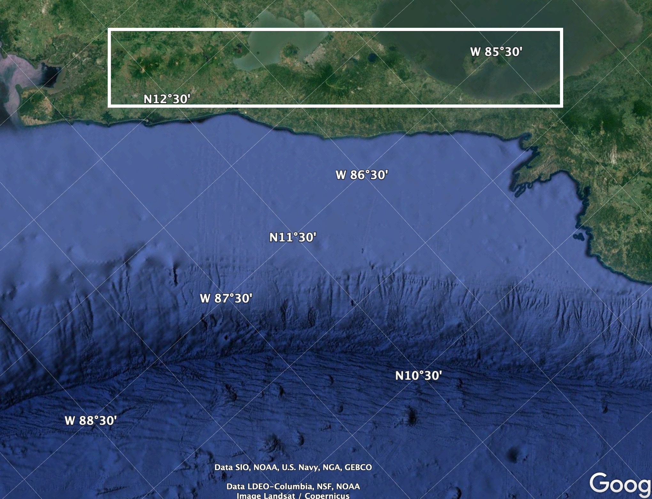
Continental Volcanic Arc and Trench
Peru Chile trench from Nazca plate subduction
Highlighted box is the volcanic arc and it continues all the way on the left. Any dark green discoloration is a volcano

Slide 3
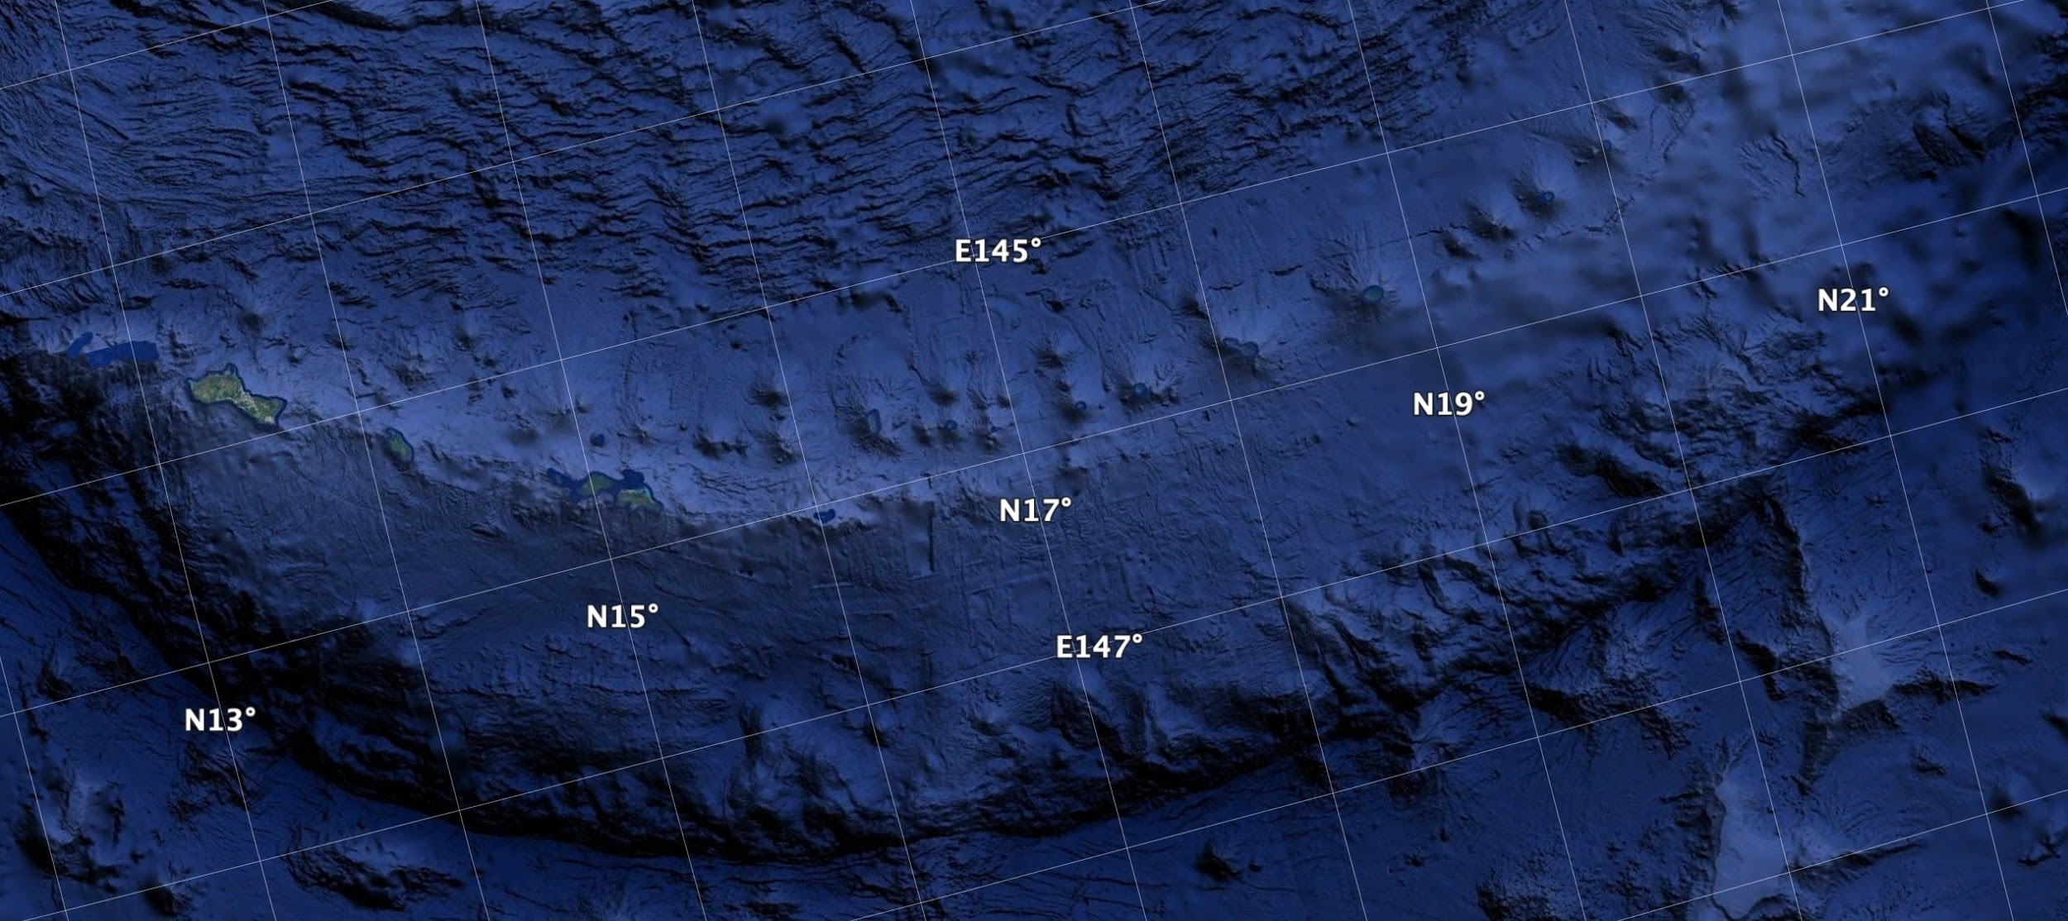
Island Volcanic Arc and Trench
Island Arc near the tropic of cancer
The trench is a subduction with the pacific plate subducting under the philippine plate

Slide 4
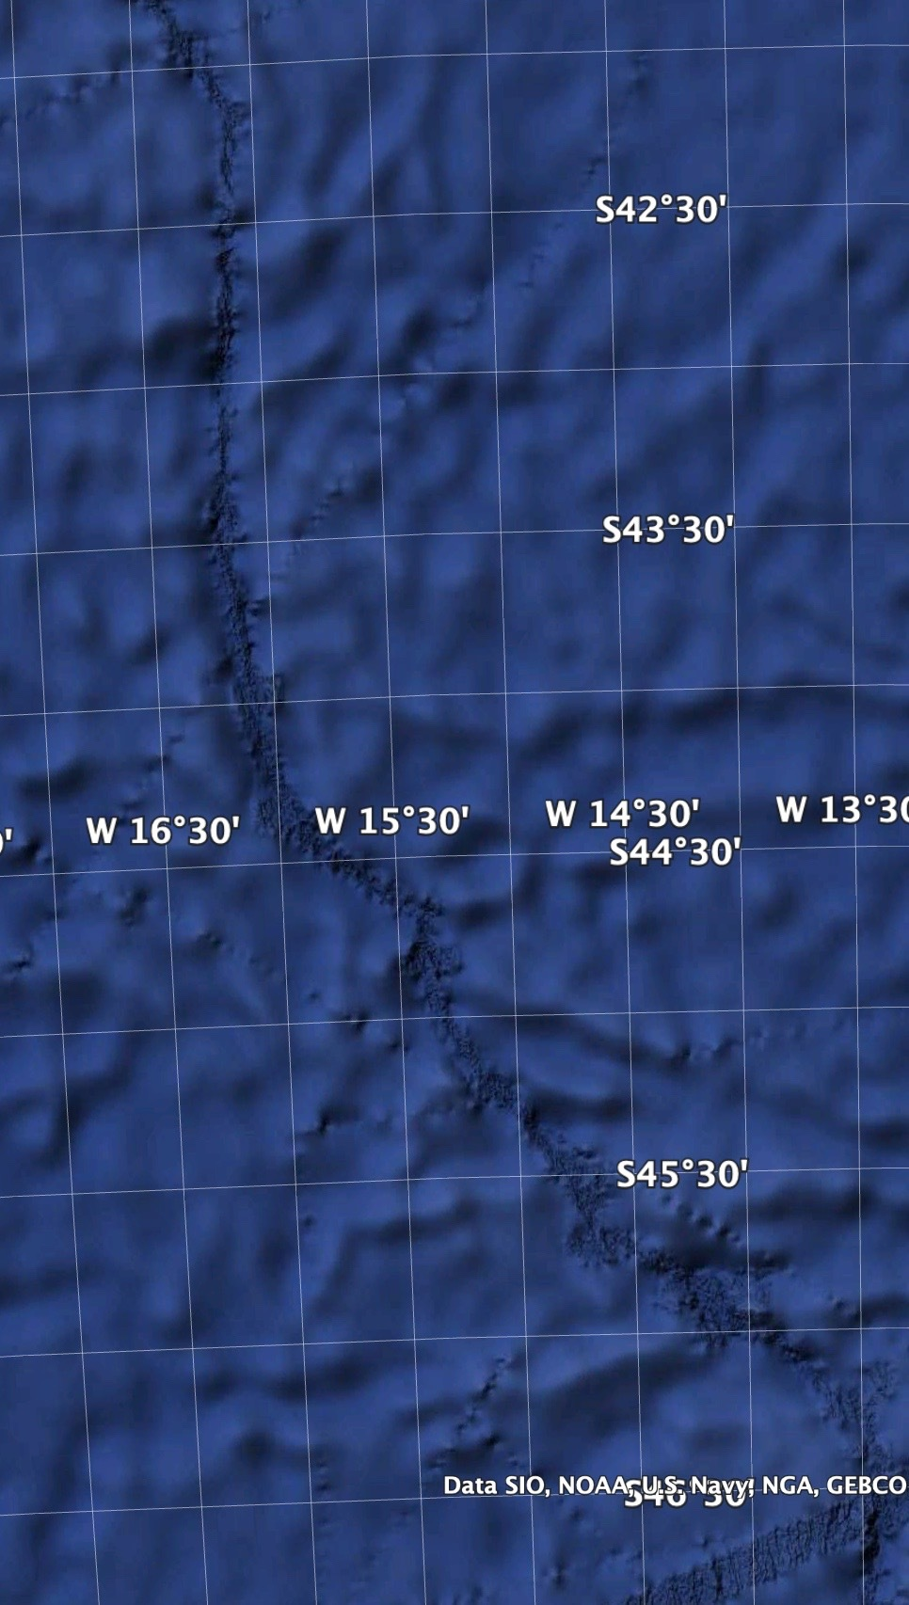
Mid Ocean Ridge
Mid Atlantic Ridge in between Africa and South America

Slide 5
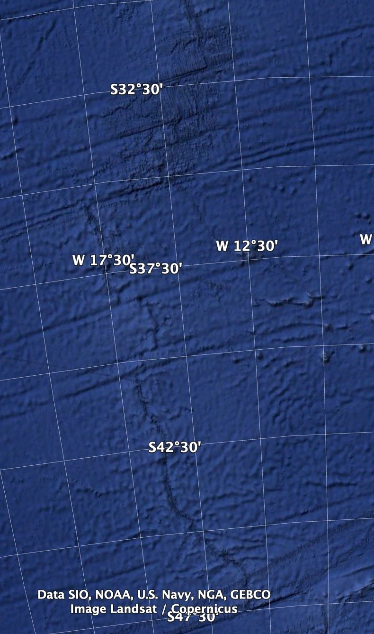
Transform Fault
Fault located in the Mid Atlantic Ridge
There are multiple but main fault is the arrow

Slide 6
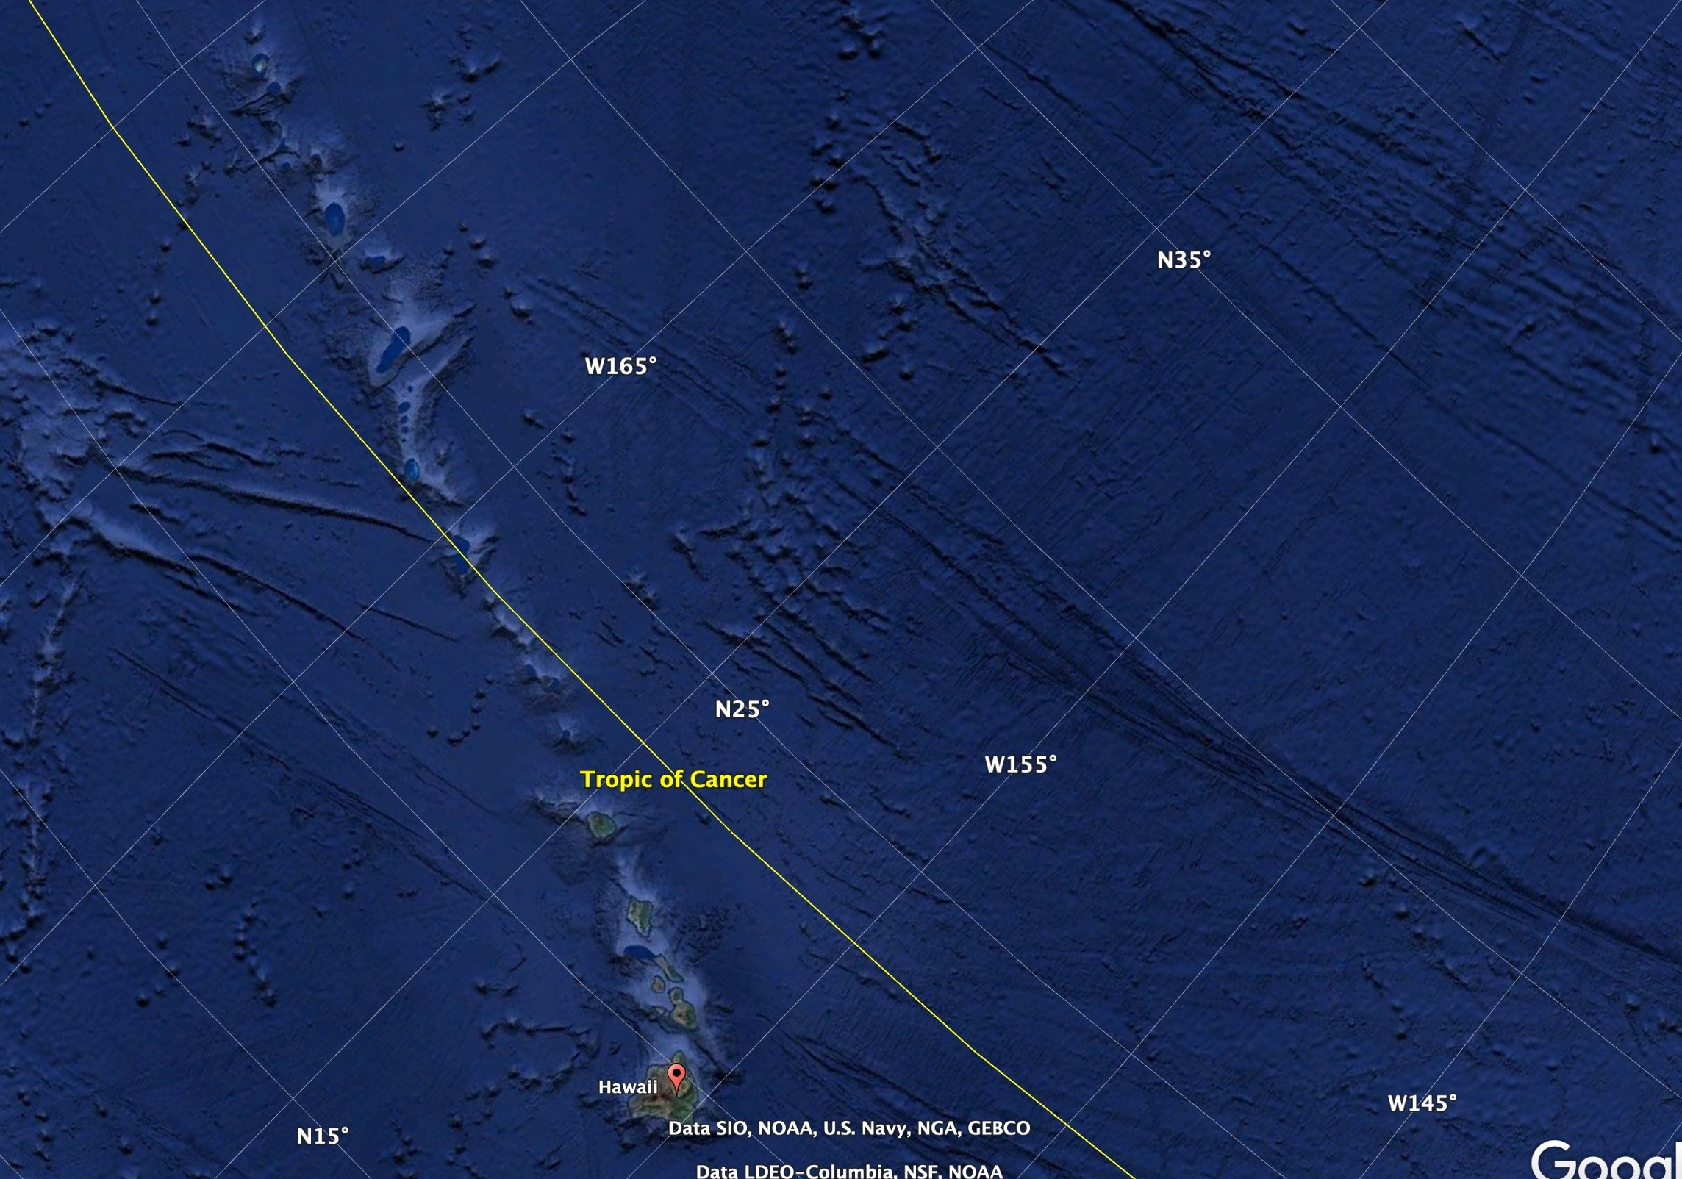
Hotspot Volcano Chain
Hawaii islands, one of the biggest hot spot chains
Independent of tectonic activity

Slide 7
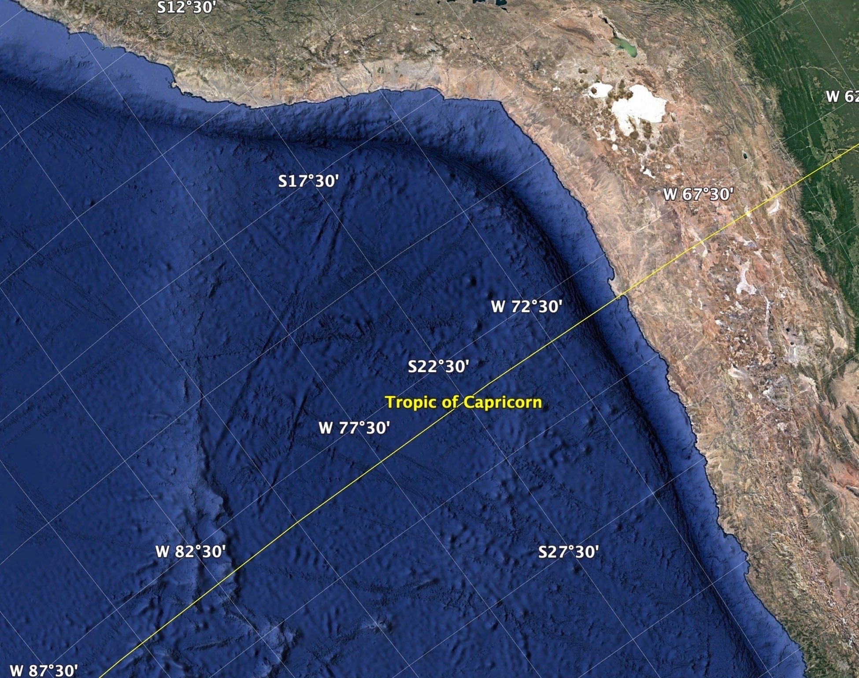
Continent Continent Collision Zone
Nazca plate subduction on coast of South America
Brown is the continental crunching and deformation occurring from subduction

Slide 8
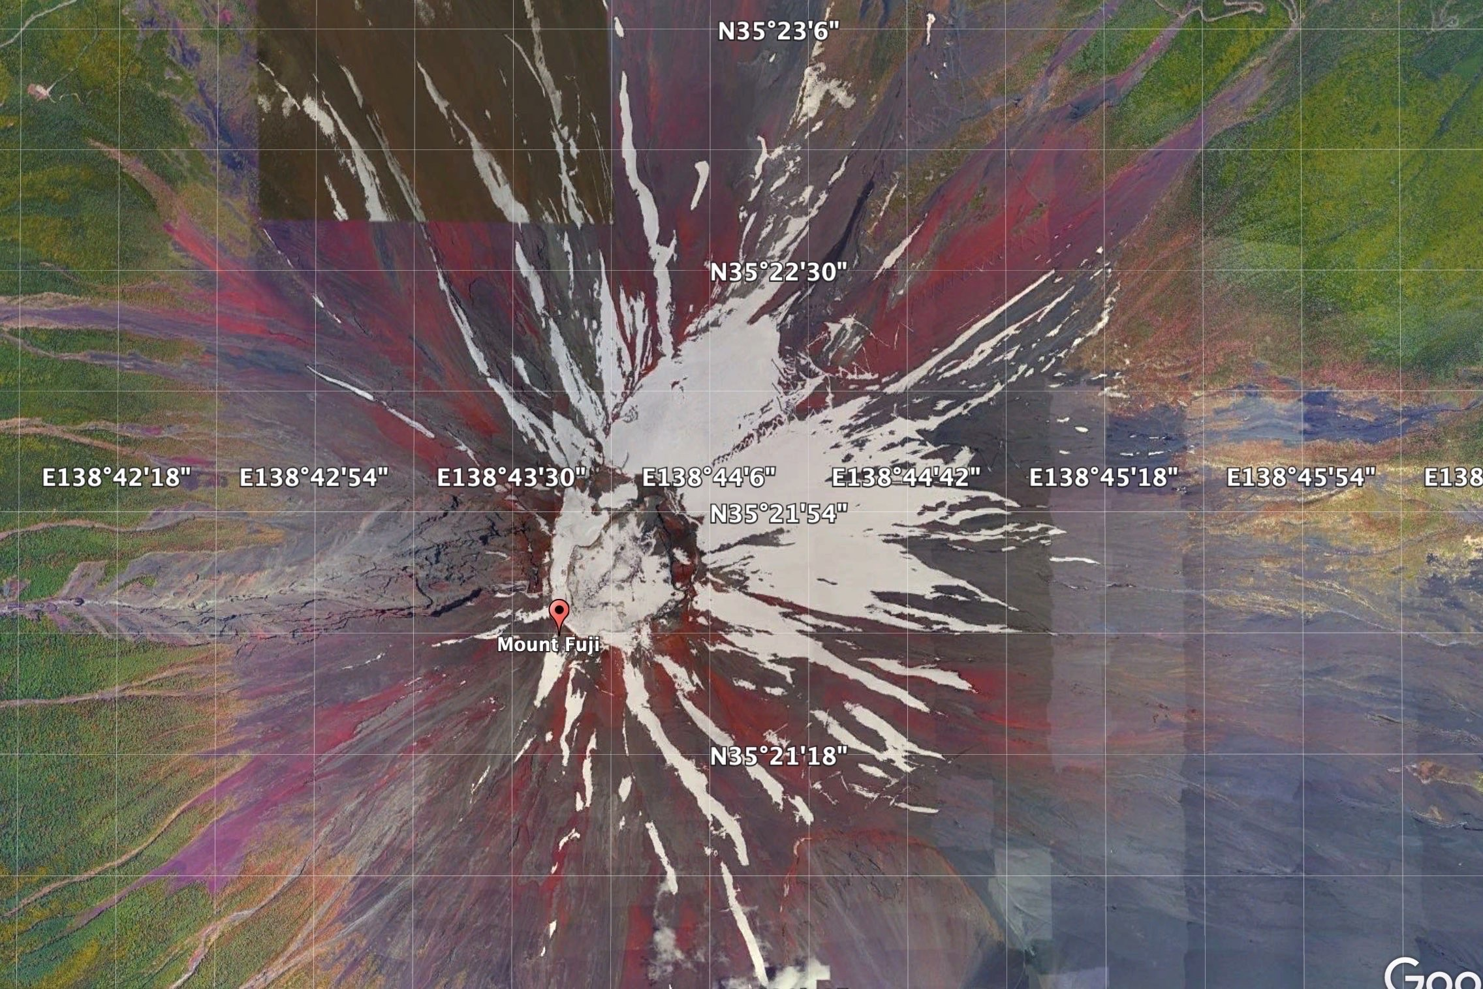
Stratovolcano
Mount Fuji located in Chūbu region, Honshu, Japan
Last Eruption was December 16th 1707

Slide 9
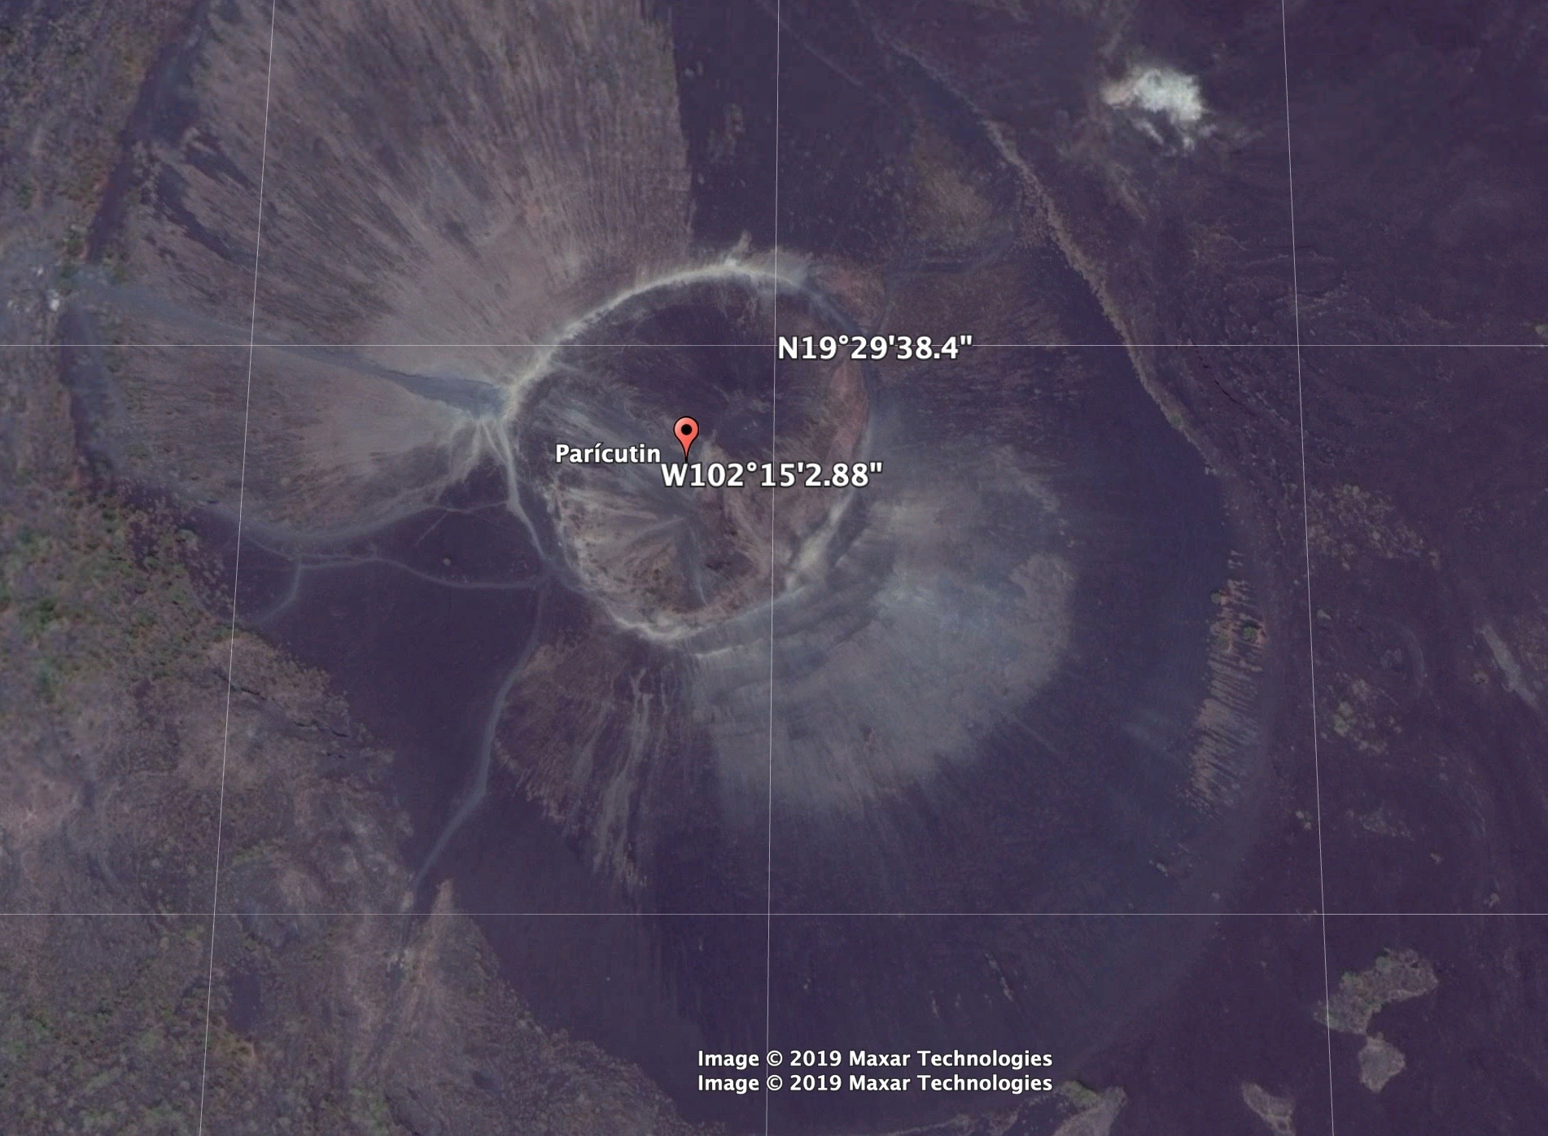
Cinder Cone
Parícutin Volcano located in Michoacán Mexico
Erupted suddenly from the ground in a farmers corn field

Slide 10
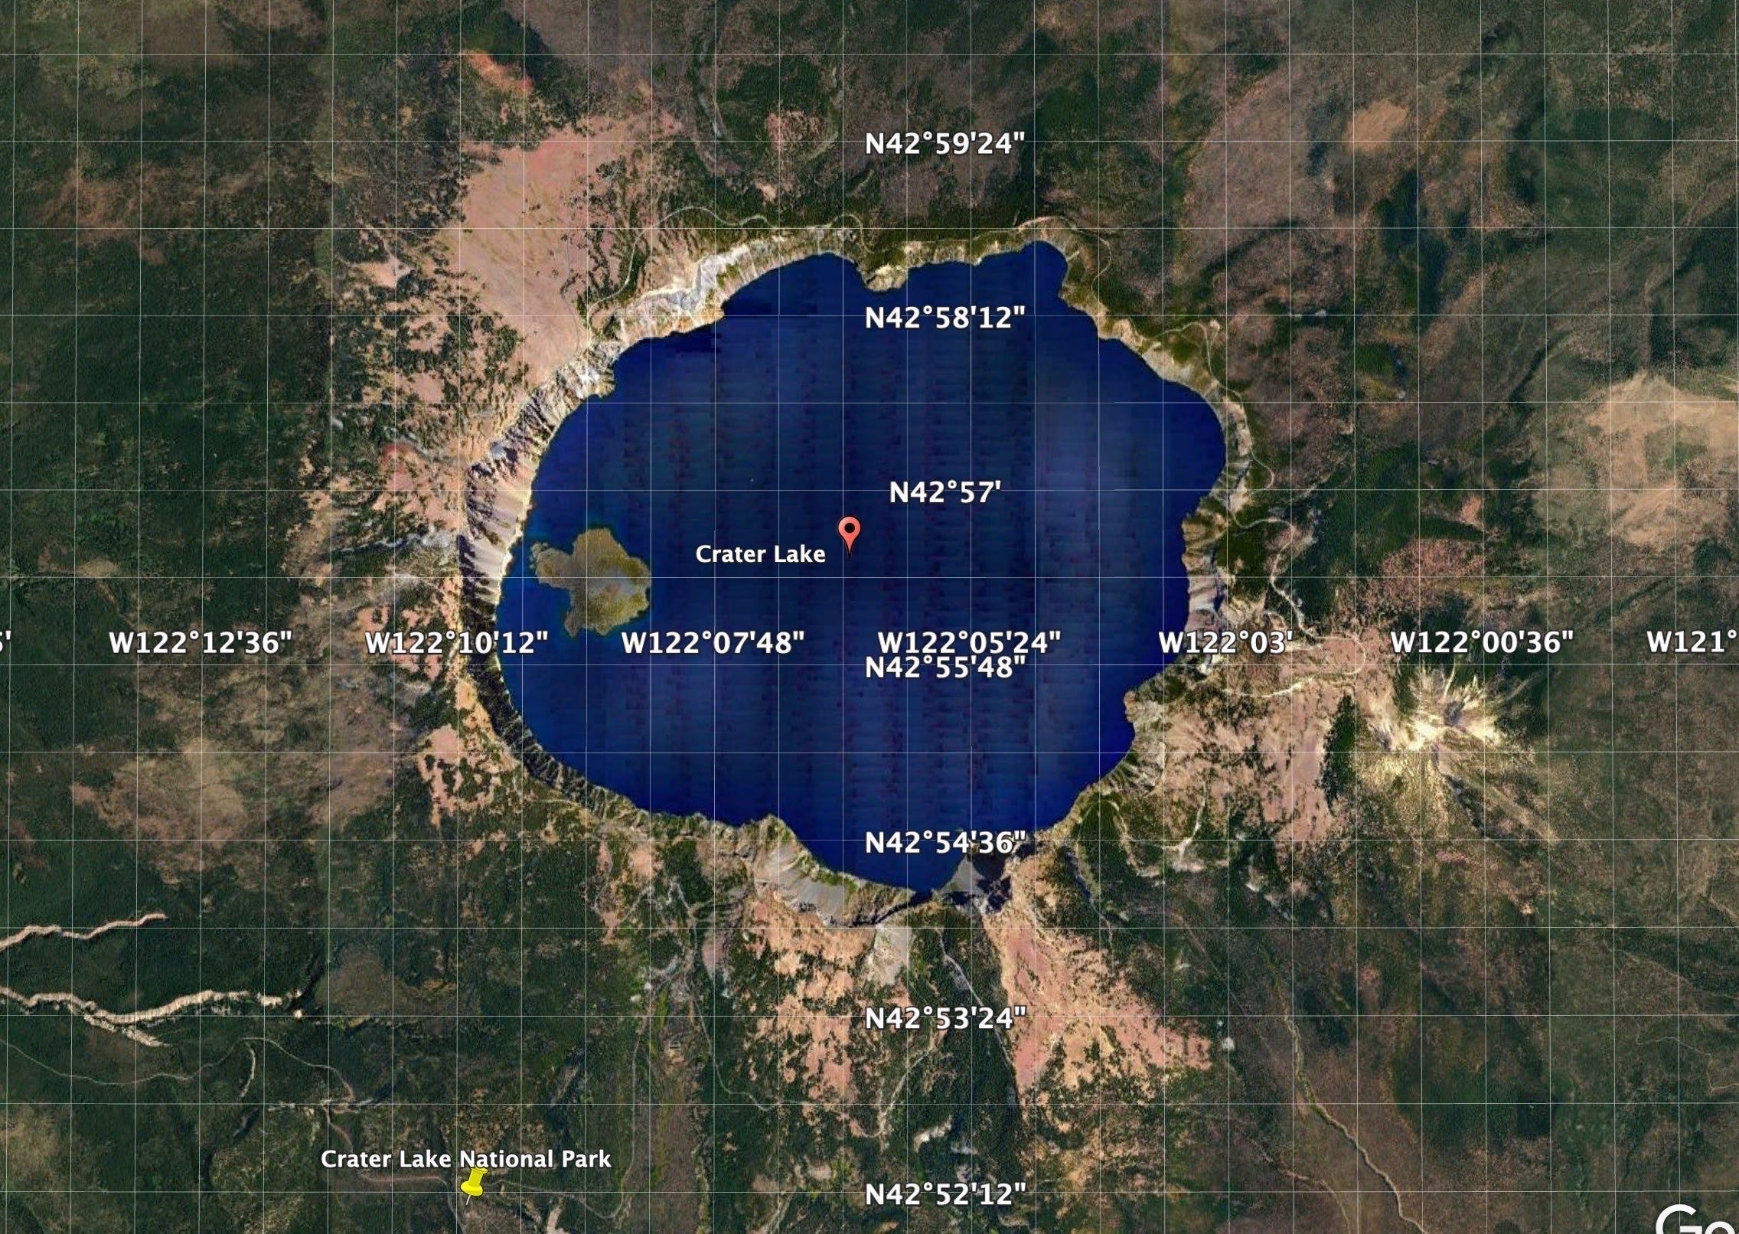
Caldera
Crater lake located in Crater Lake National Park in Oregon

Slide 11
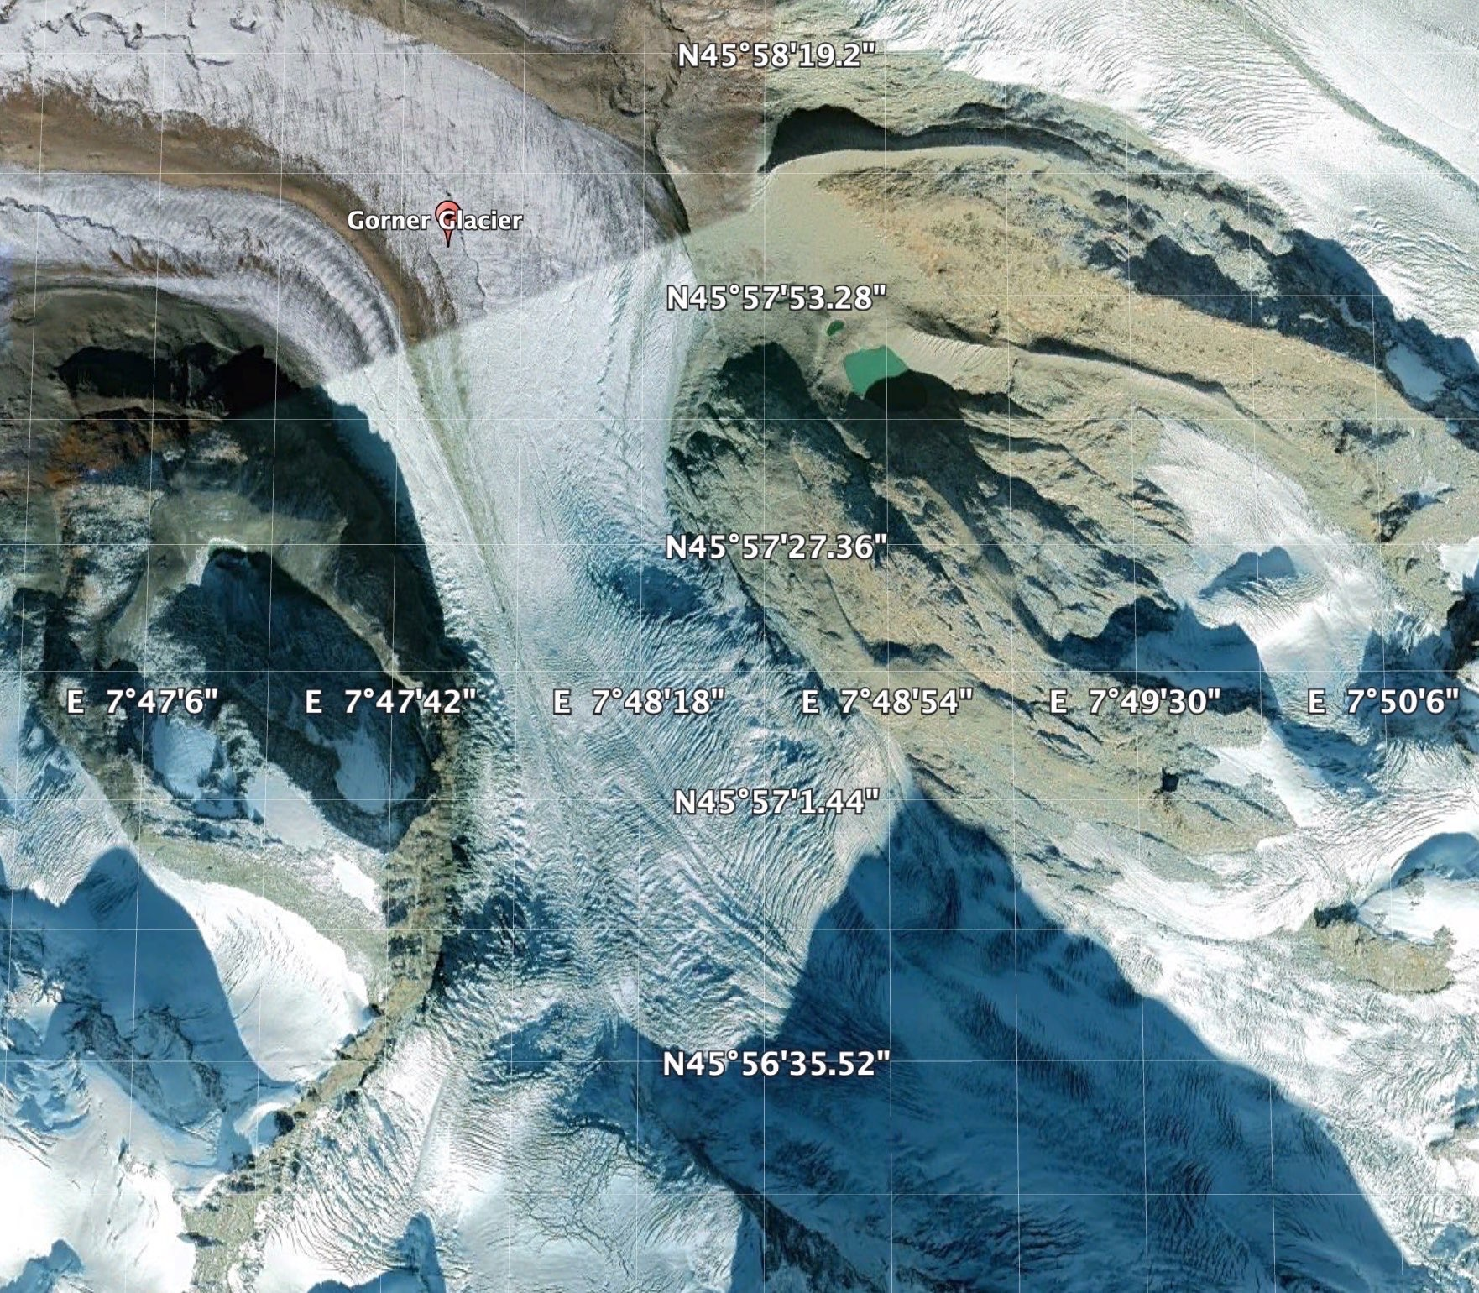
Alpine Glacier
Gorner Glacier in Valais, Switzerland
Glacier extends about 7 miles and is around one mile in width

Slide 12
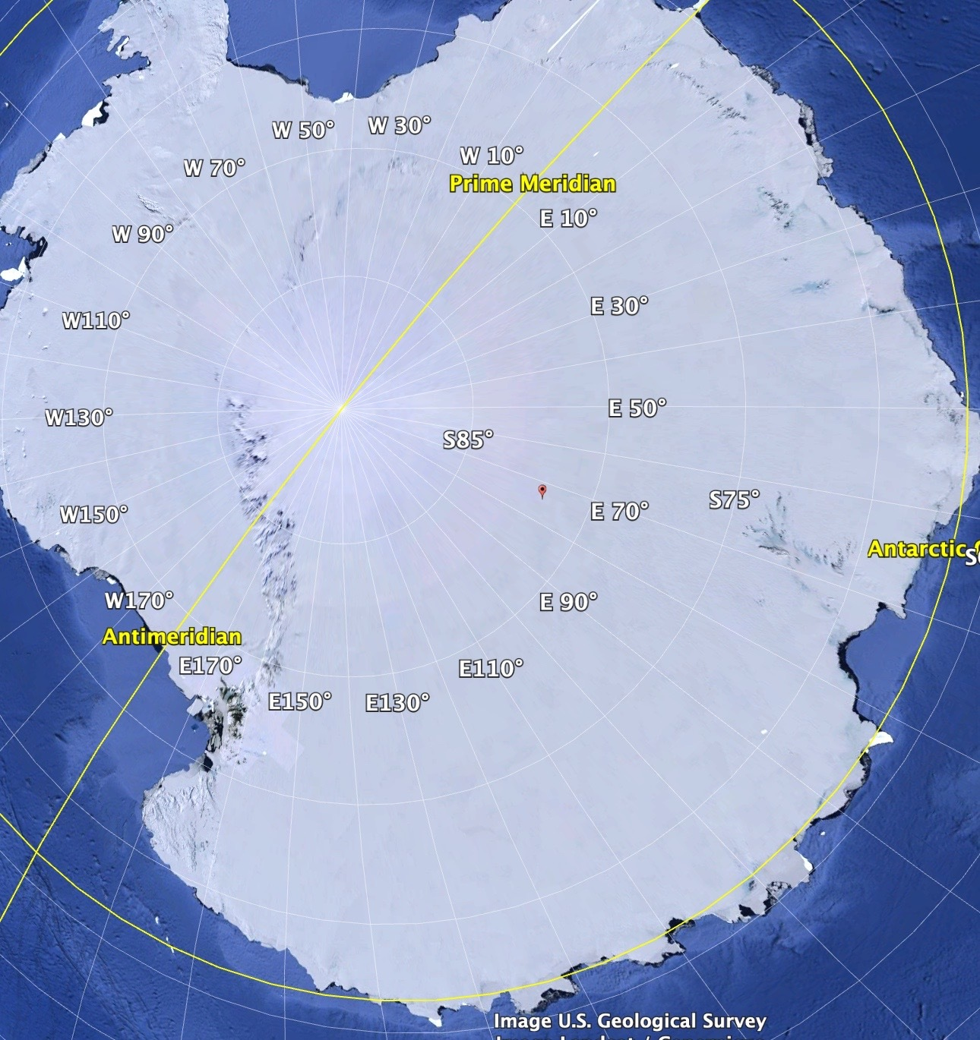
Continental Glacier
Antarctic Continent
Antarctica is over 90% ice

Slide 13
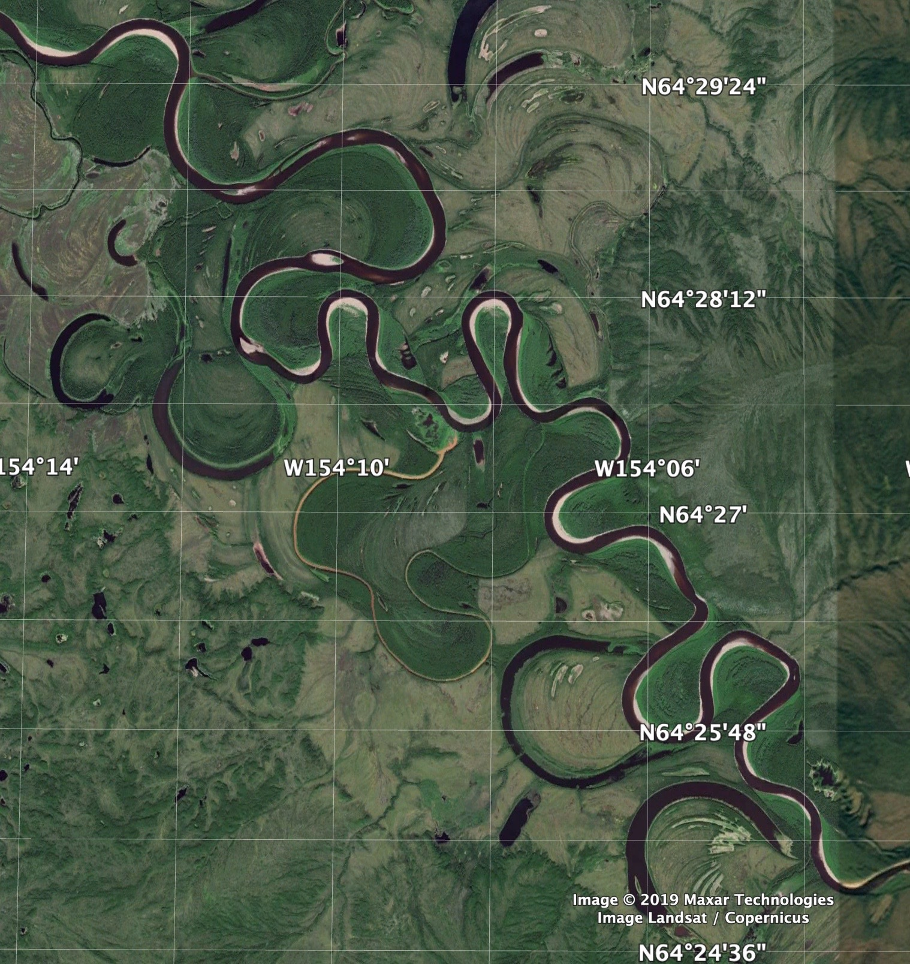
Meandering River
Nowitna River in Alaska
River Extends over 250 miles

Slide 14
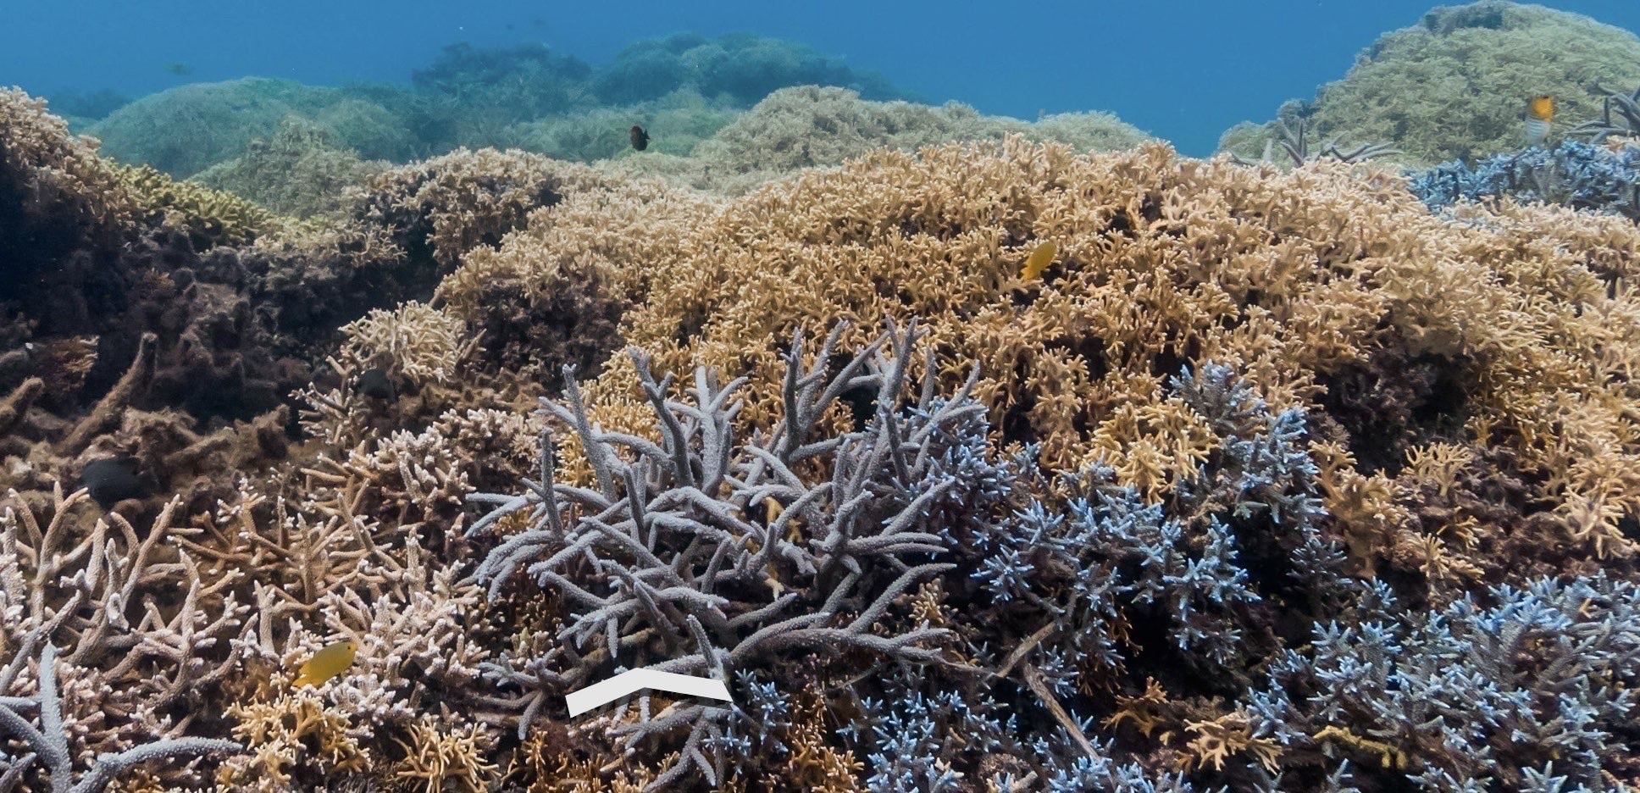
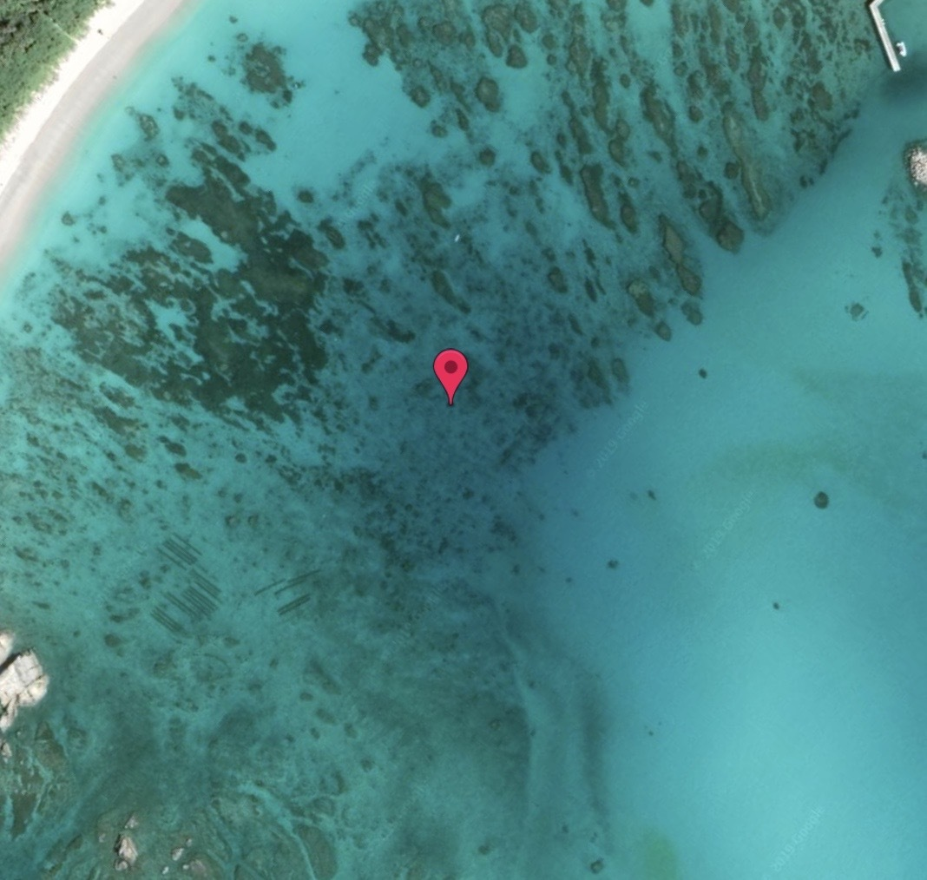
Coral Reef
Aharen Beach
Tokashiki, Okinawa

Slide 15
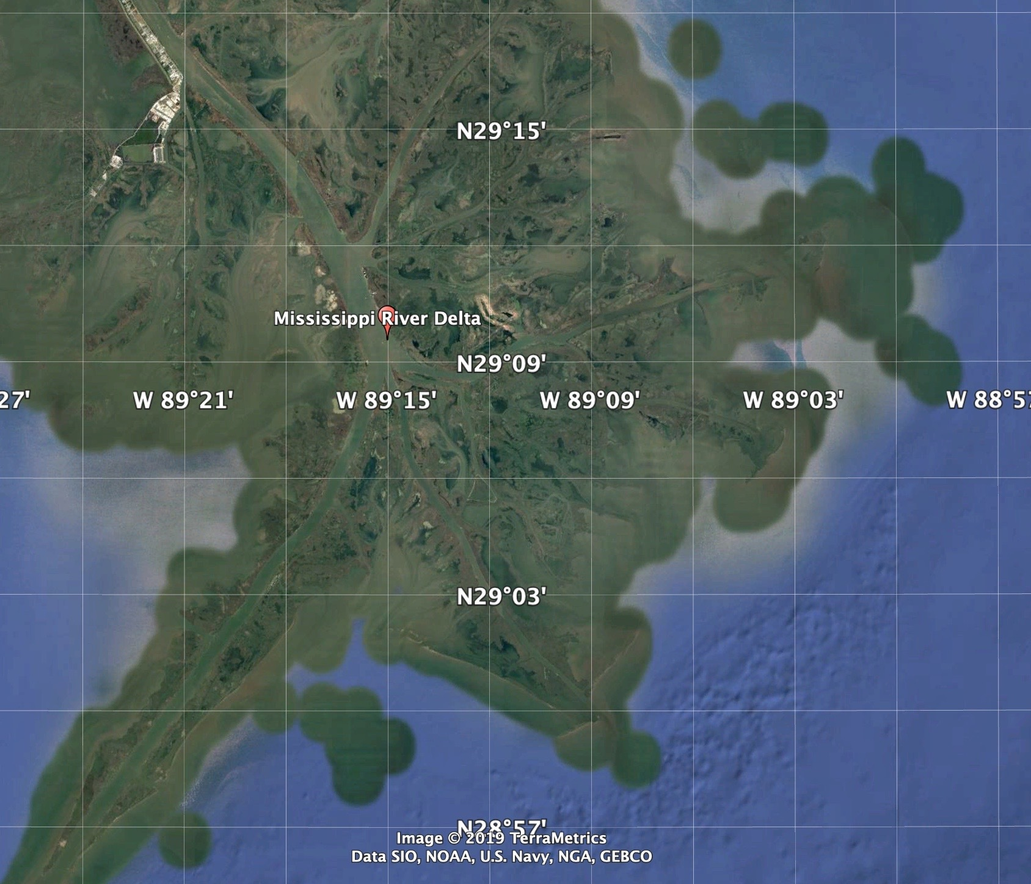
Delta
Mississippi river delta connecting To the gulf of mexico
Most of the green splotches on the side of the delta are caused by a process known as eutrophication

Slide 16
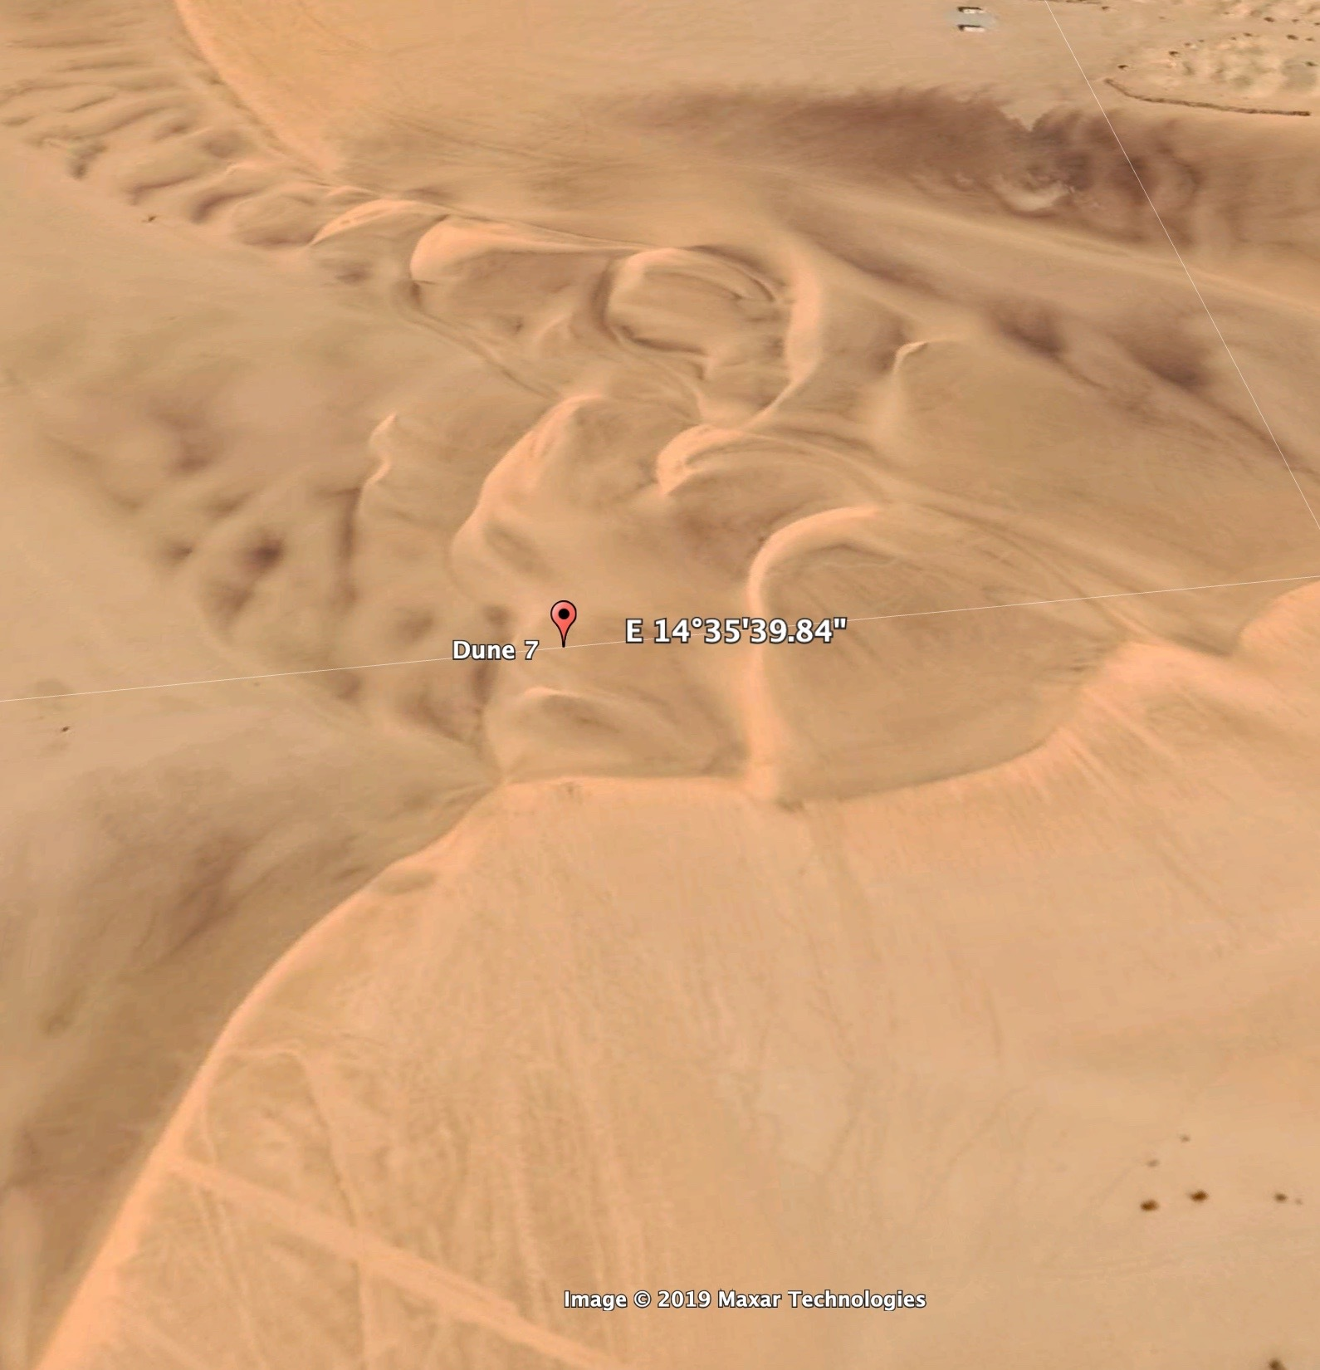
Sand Dunes
Walvis Bay, Namibia, Largest Sand dune in Namibia and a hosting location for many sports

